Slide 1
Marriott Lecture App Dev Section
Zhuangwei Kang

Slide 2
Roadmap
Motivation
App Scenario & System Architecture Design
Key Techniques Leveraged in the IoT App
Alexa Custom Skill & AVS
Serverless Computing (AWS Lambda)
MQTT
Flask
DynamoDB
IFTTT
Demo of an Insecure Version
Security Enhancement of This App

Slide 3
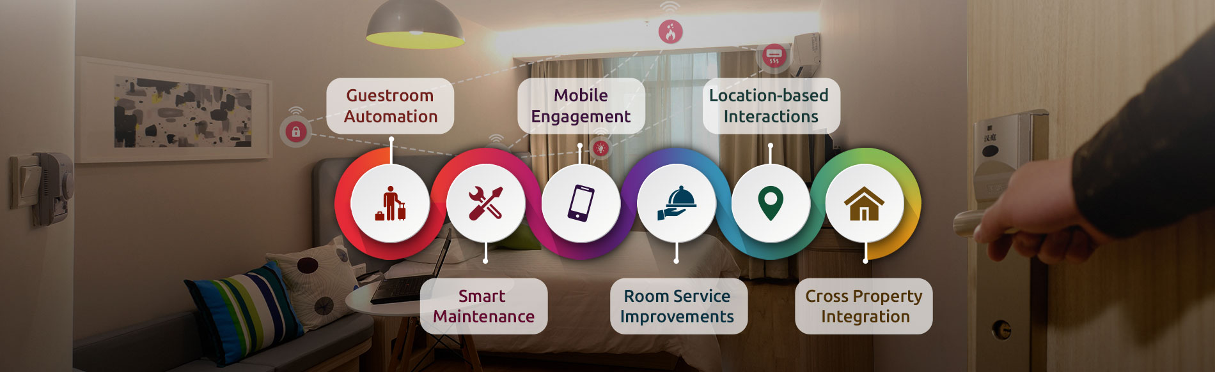
Motivation(1/2)
Hotel service has been completely redefined with the significant development of IoT techniques.

Slide 4
Motivation(2/2)
Main Features of Modern Hotel Service:
Intelligent
Convenient
Humanized
Efficient
Thinking: What smart IoT techniques are leveraged in Marriott hotel service?

Slide 5
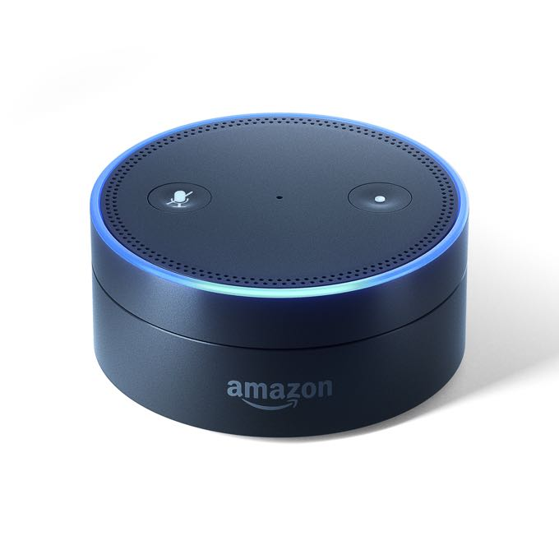






App Scenario
Room 101
Ok, let me notify dining room
Order a pizza
Room 101 needs a pizza
Room 101 needs a pizza
We are preparing your foods, thanks for ordering
Pizza is available, this order has been confirmed
My receipt
Customer receipt
Light up hue

Slide 6
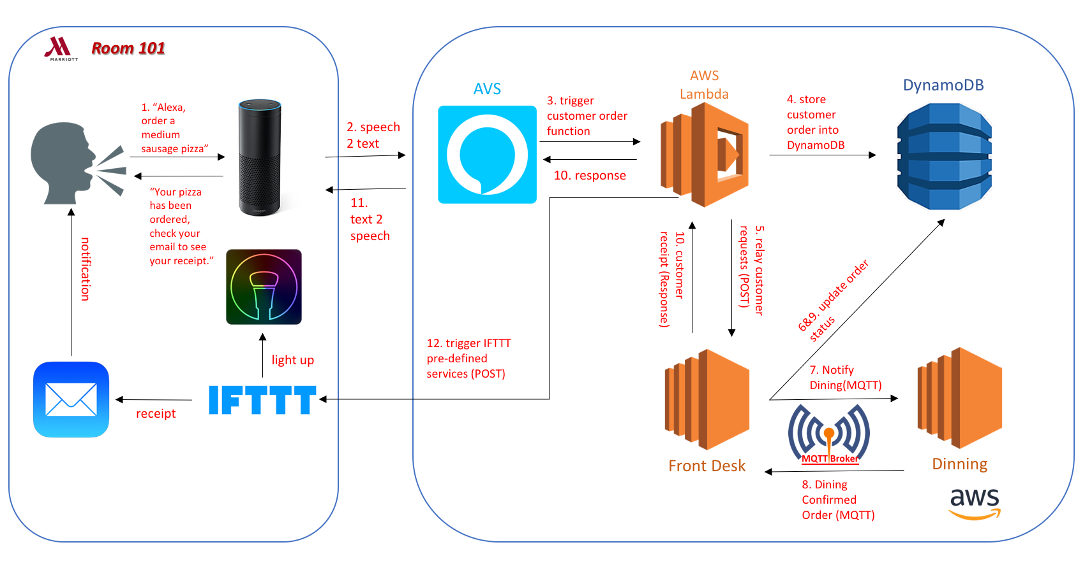
System Architecture

Slide 7
Technology and Protocol

Slide 8
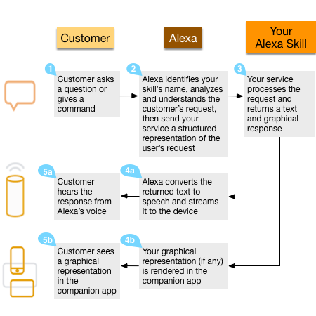
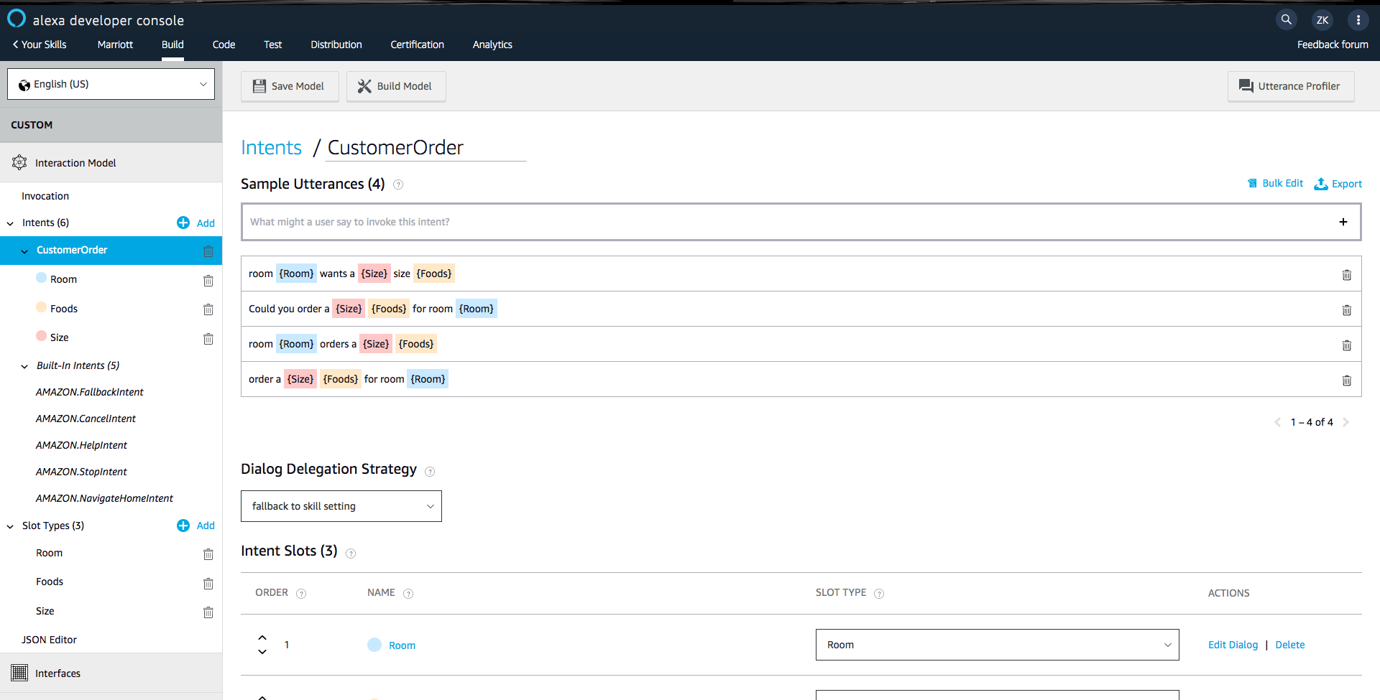
Alexa Custom Skill(1/2)
Processing Procedures:
Define Alexa Custom Skill:

Slide 9
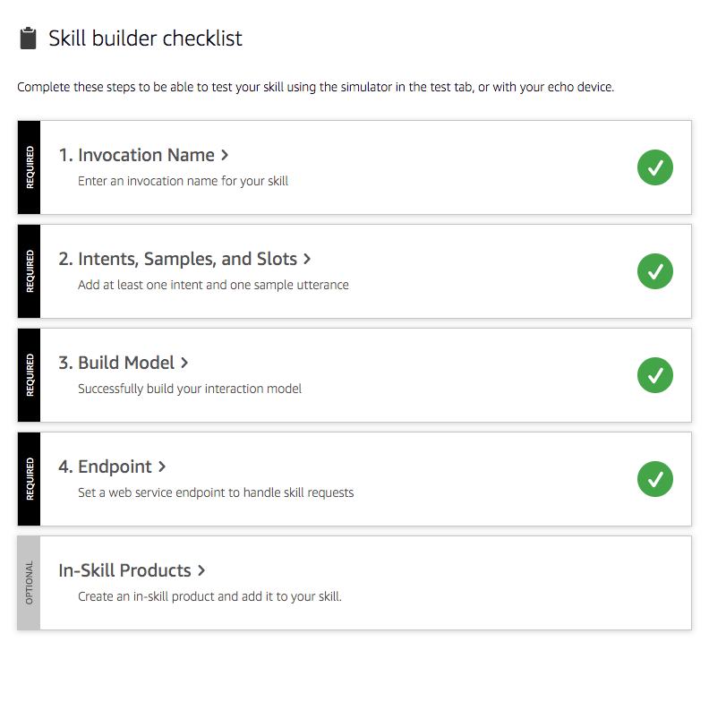
Alexa Custom Skill(2/2)
Key Notions in Alexa Custom Skill
Invocation Name: Few words for invoking your skill, like “Alexa” is the default invocation name.
Intents: similar to an event, such as “clean room”, “order foods”, etc.
Slots: components of an events, for example, in a “order foods” event, user always need to provide “food name”, “room id”, etc, these components are defined as slots in Alexa.
Sample Utterance: a developer defined request format for submitting users’ voice commands. Such as, “Alexa, order a small pizza for room 101”, or you can say “Alexa, room 101 needs a small pizza” Not only request, developers also can define how does Alexa respond them. It’s also sample utterance.
Endpoint: a platform to handle skill requests, such as AWS Lambda.

Slide 10
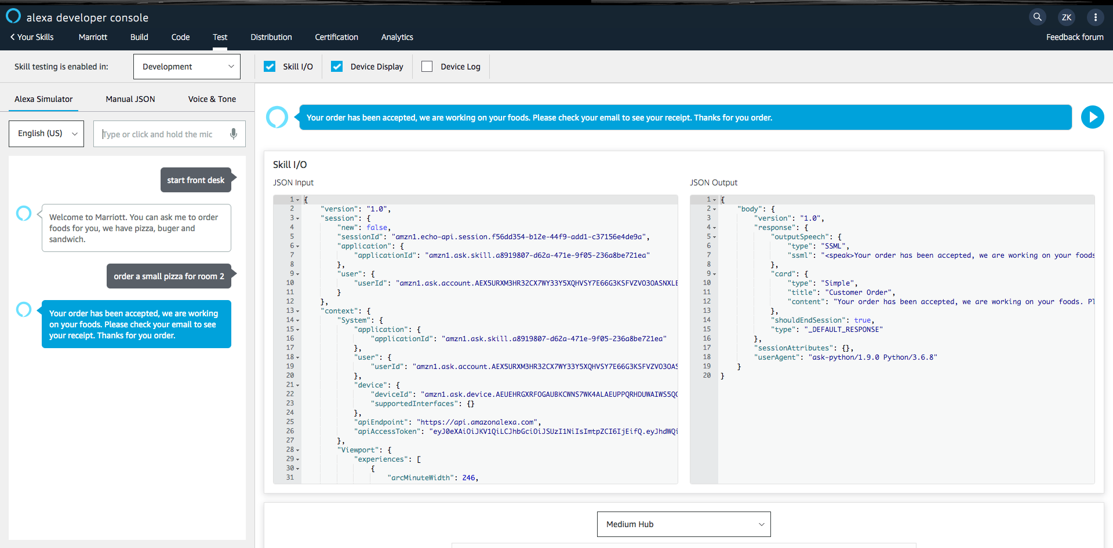
Alexa Voice Service
Convert user’s voice input stream received from Echo to a json object.
Convert Lambda’s json output, which is the response for user’s request, to a voice stream.

Slide 11
AWS Lambda(1/2)
AWS Lambda is an event-driven, serverless computing platform provided by Amazon as a part of the Amazon Web Services. It is a computing service that runs code in response to events and automatically manages the computing resources required by that code.
Two features:
Event-driven: the flow of program is determined by events such as user’s action, in our case, user’s action is their voice input
Serverless computing: it does not need a server. It means servers are managed by cloud provider like AWS, Azure, AliCloud, etc. Developers don’t need to manage server by themselves and resources are dynamically allocated by cloud provider.
Servers are short-lived and get created on demand.
AWS uses it to consolidate idle physical resources.

Slide 12
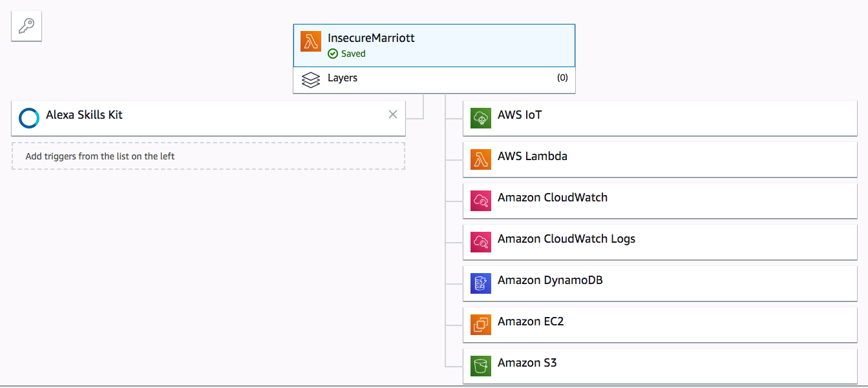
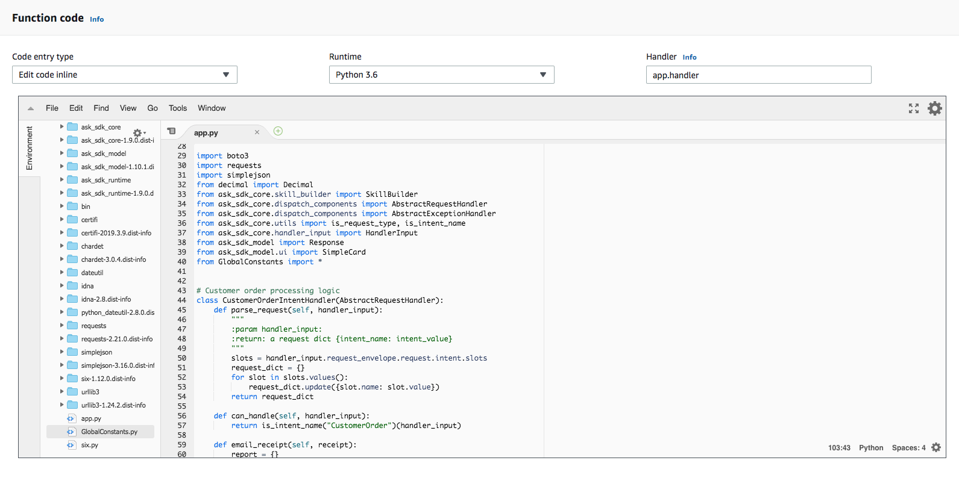
AWS Lambda(2/2)
Schema Design
Function Code

Slide 13
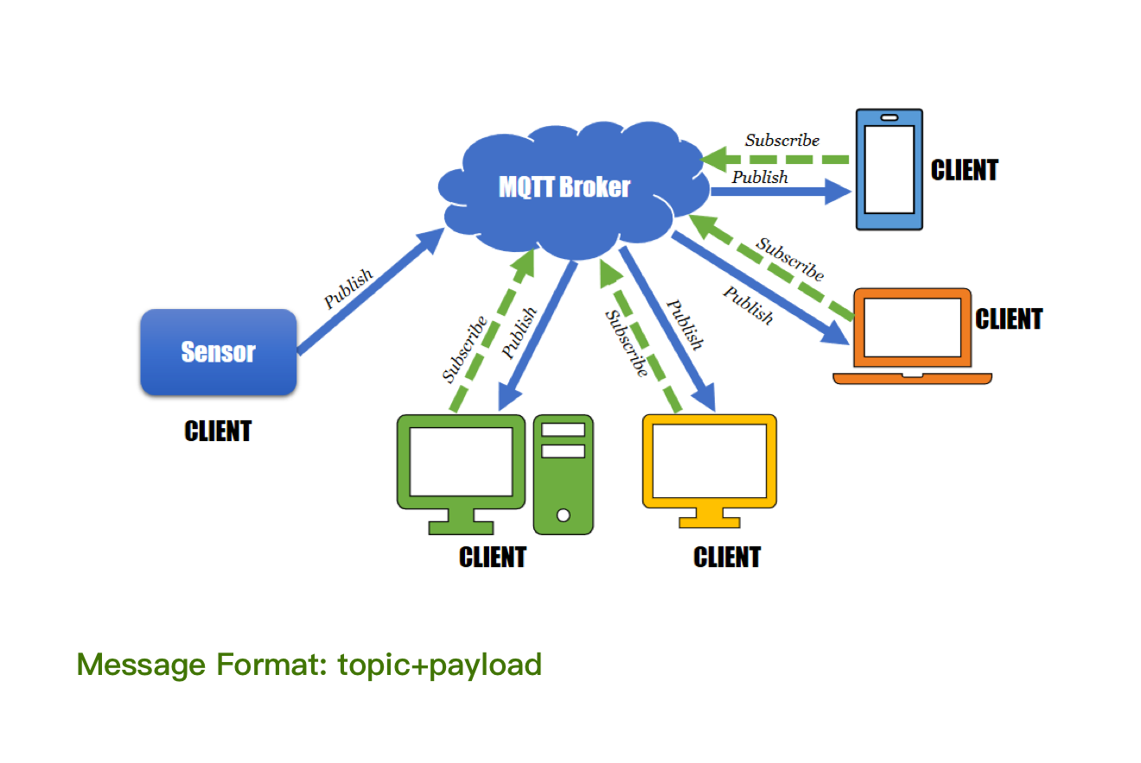
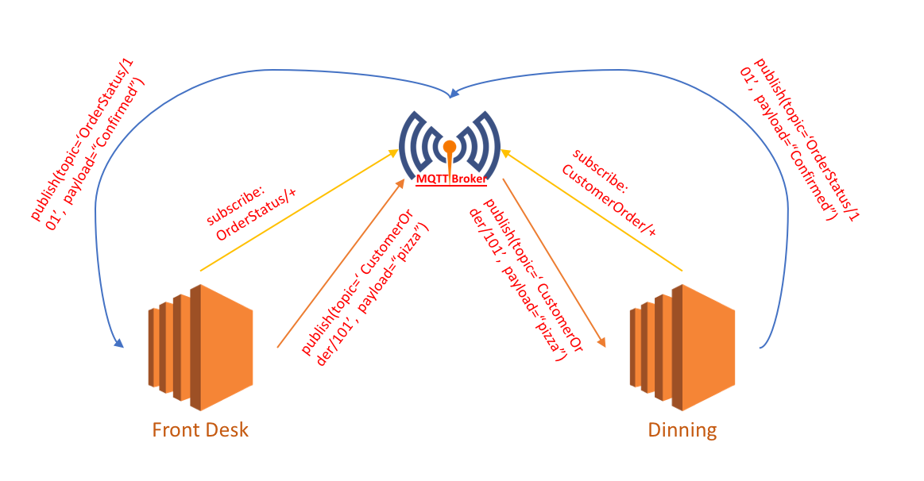
MQTT(1/2)
MQTT is a lightweight publish/subscribe message transportation protocol that works on top of TCP/IP protocol.
Roles in MQTT system:
MQTT clients: publishers or subscribers
MQTT server(broker): can run on MQTT online server or your own server. There is a Topic Filter in broker to map messages received from publishers to subscribers.

Slide 14
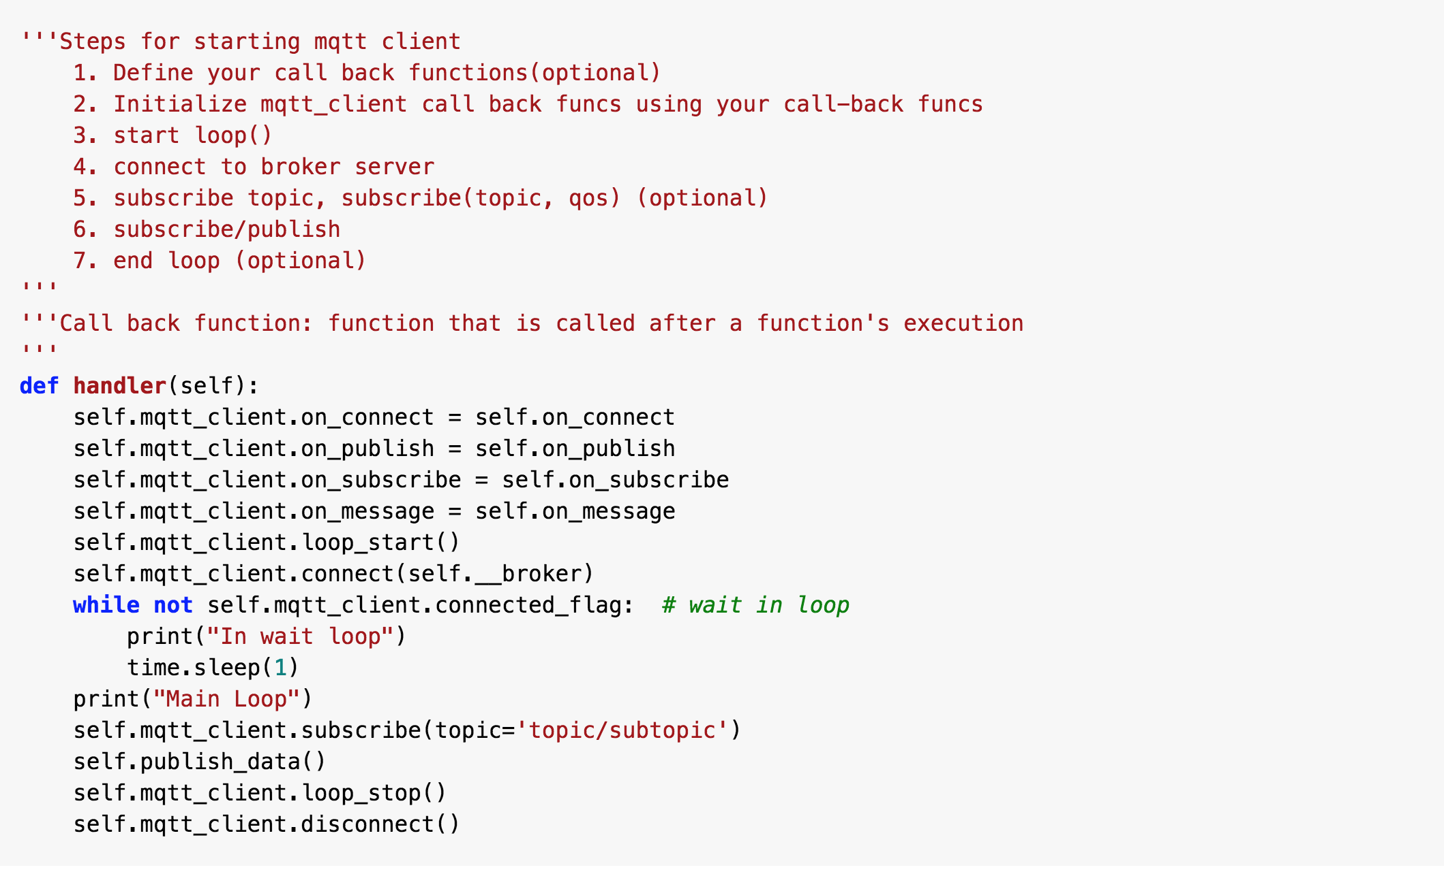
MQTT(2/2)
MQTT Python API:
paho-mqtt
A piece of insecure sample code:

Slide 15
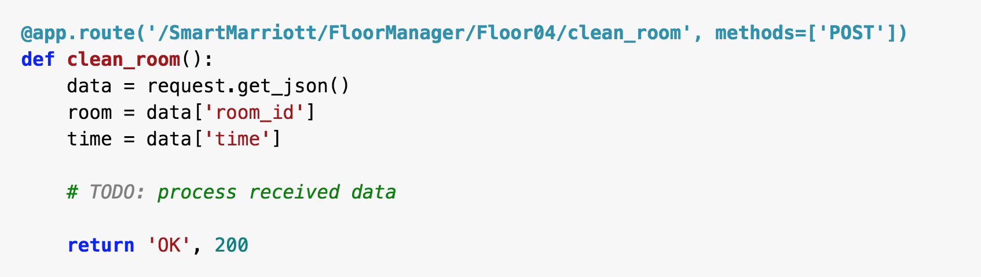
Flask
A popular Python web framework, in other words, it’s a third-party Python library for developing web applications.
Assuming your URL is: http://129.11.22.33:5000/cutomer_order
And you send a json object to server using POST method.
What does flask do?

Slide 16
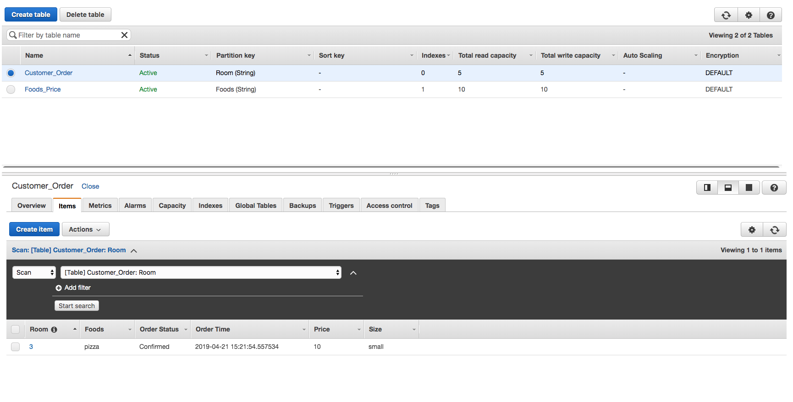
DynamoDB
Amazon DynamoDB is a key-value and document NoSQL database that delivers single-digit millisecond performance at any scale.

Slide 17
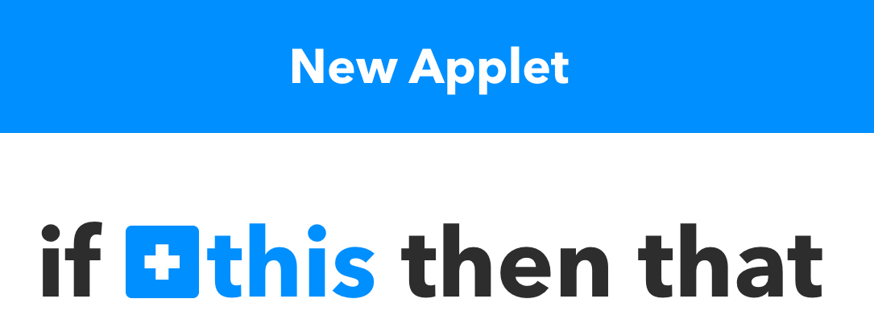
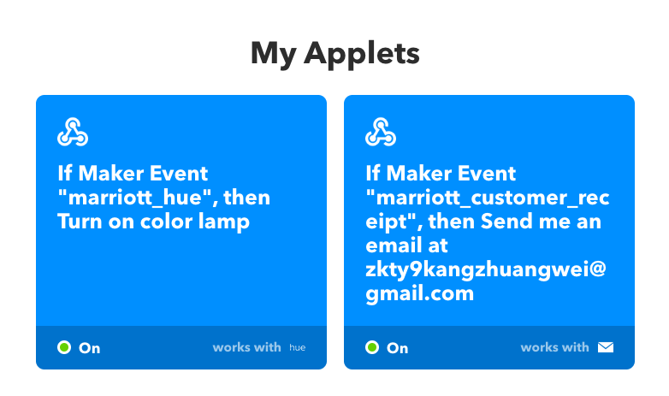
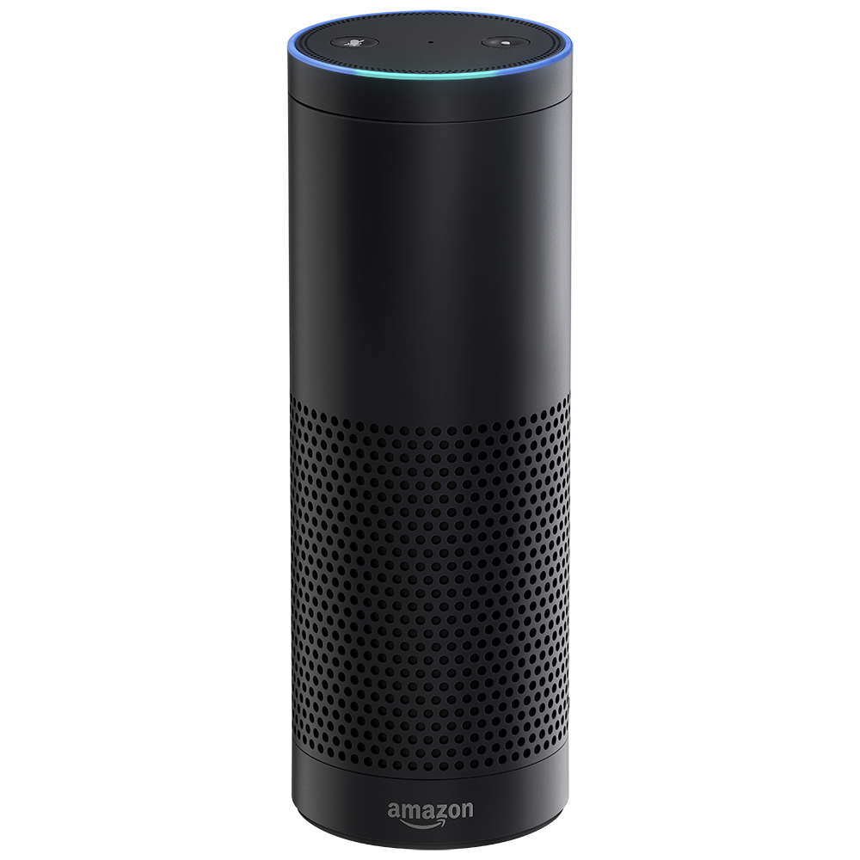



IFTTT
Key Idea: An applet is triggered by changes that occur within other web services.
How to trigger an email notification from an Alexa based service?
HTTPS POST
trigger
if
then

Slide 18
Demo 1
https://youtu.be/4IwHCY2jk5k

Slide 19
Demo 2
https://youtu.be/Np4iNdDiorI

